Slide 1
Earthquake Damage Model
Submitted by: Team Adelaide​
Ishaan Sinha - 20is38@queensu.ca
Marshal Yuan - 21yy40@queensu.ca
Kripa Nayak - 21ksn1@queensu.ca​
Fiona Bai - 21jb69@queensu.ca​
Rachel Chen - 21jc69@queensu.ca
Oluwaseun Adelana - 21oa9@queensu.ca​
​

Slide 2
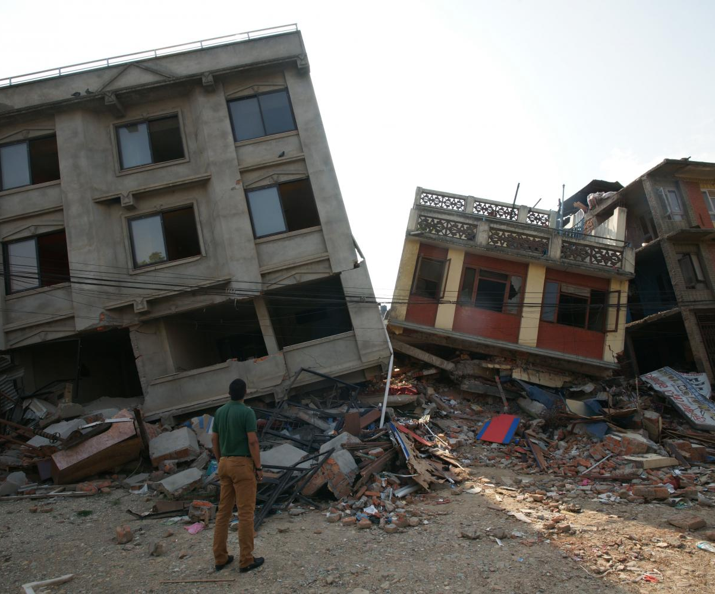
Introduction
7.8 Mw Gorkha Earthquake on April 25, 2015
A massive household survey using mobile technology to assess building damage in the earthquake-affected districts
Identify beneficiaries eligible for government assistance for housing reconstruction
Our goal is to predict the level of damage to buildings caused by the earthquake

Slide 3
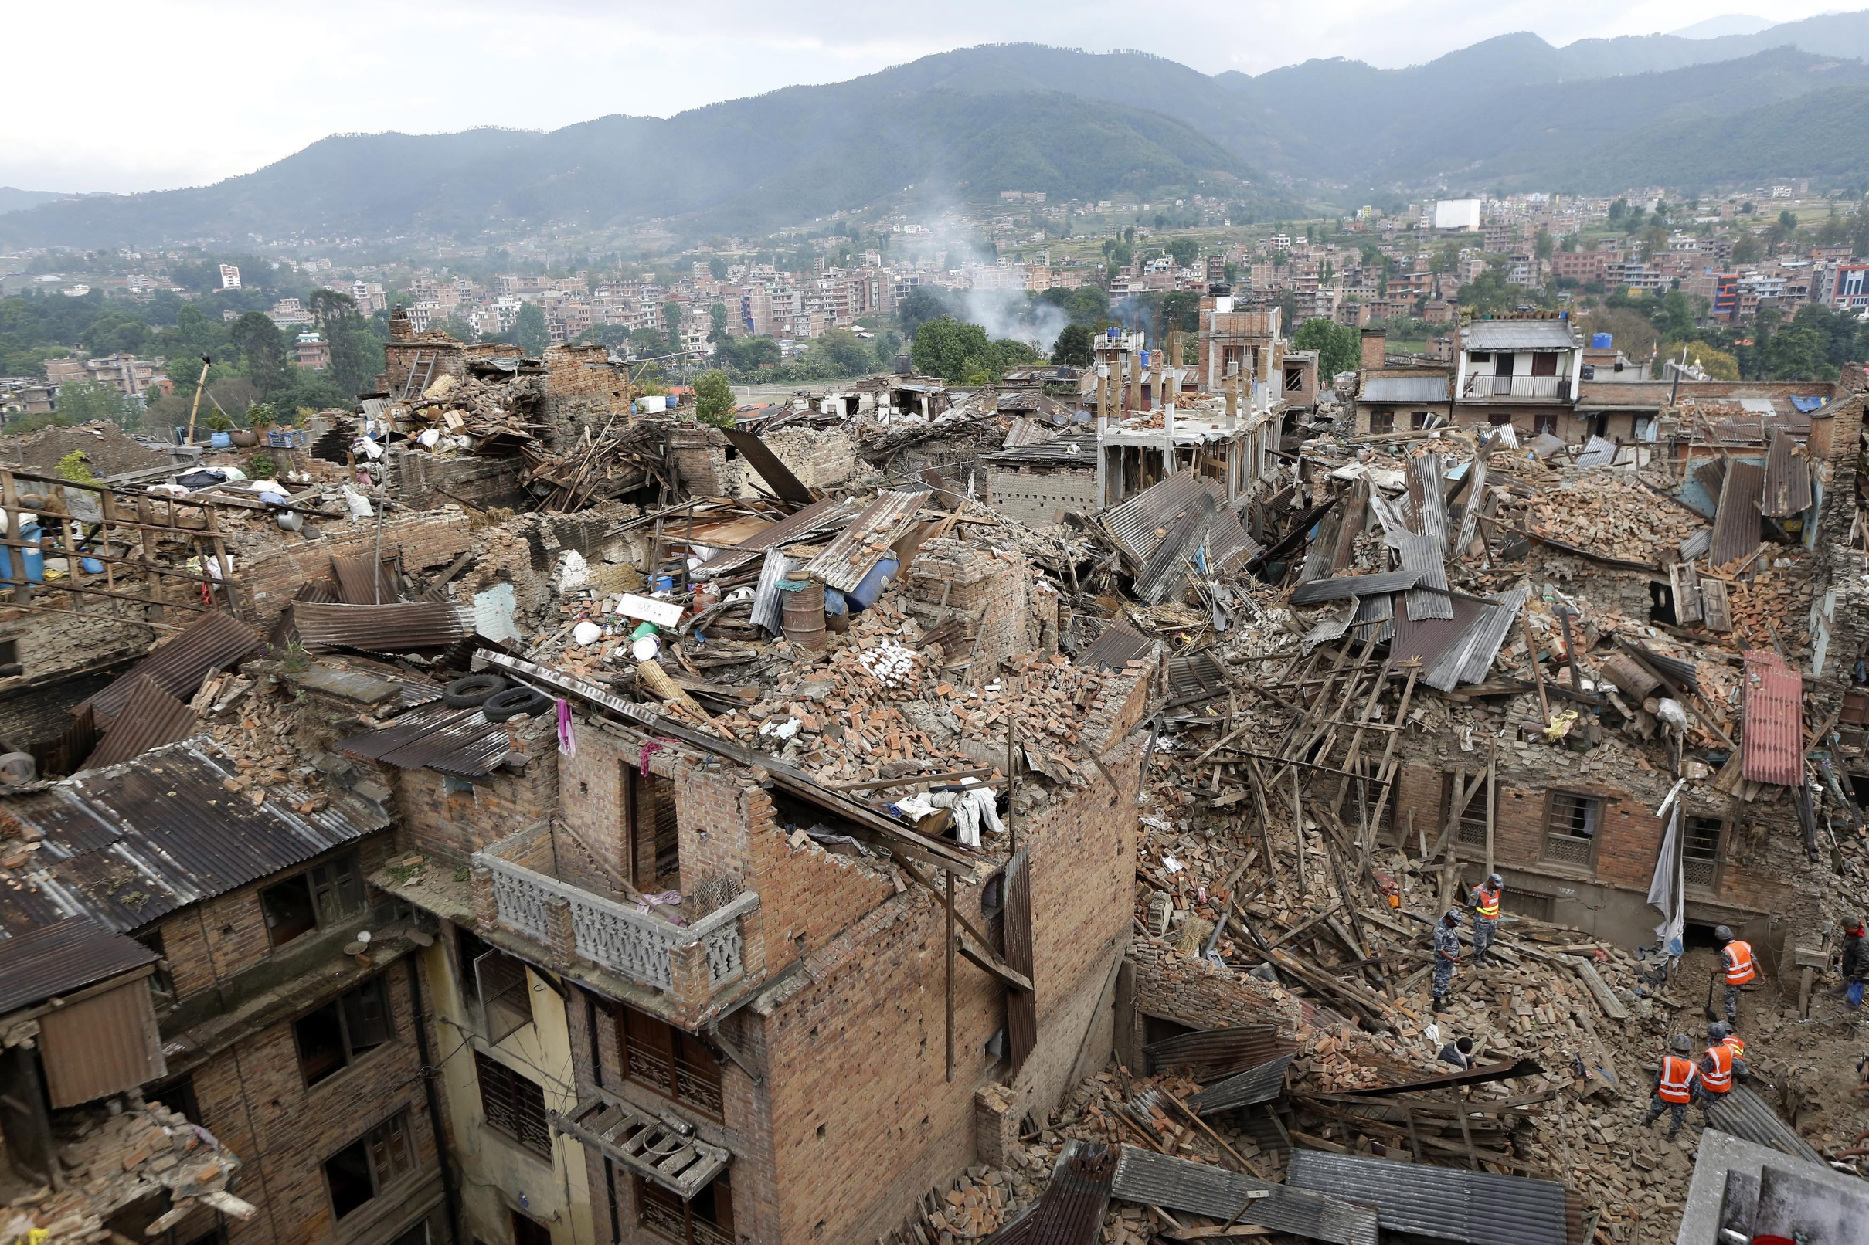
Data
The data was collected for a total of 260,601 buildings which were of different types
Different types of data
Discrete/Integer variables - 9
Binary variables - 22
Categorical variables - 8

Slide 4
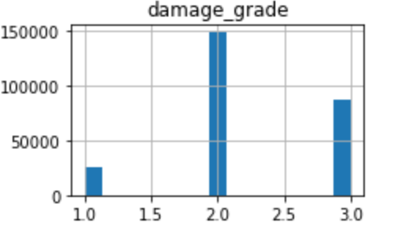
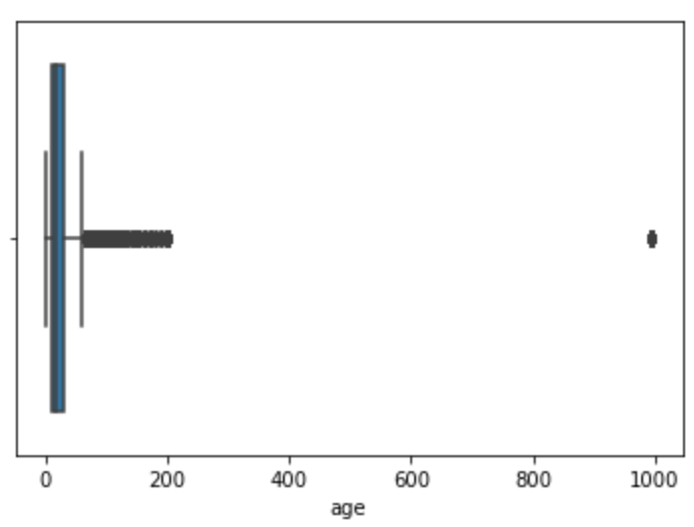
Data Cleaning
The histogram shows that the damage grade which is our target variable, is imbalanced
Outliers in "Age" variable
Damage grade 1 – 10%
Damage grade 2 – 57%
Damage grade 3 – 33%

Slide 5
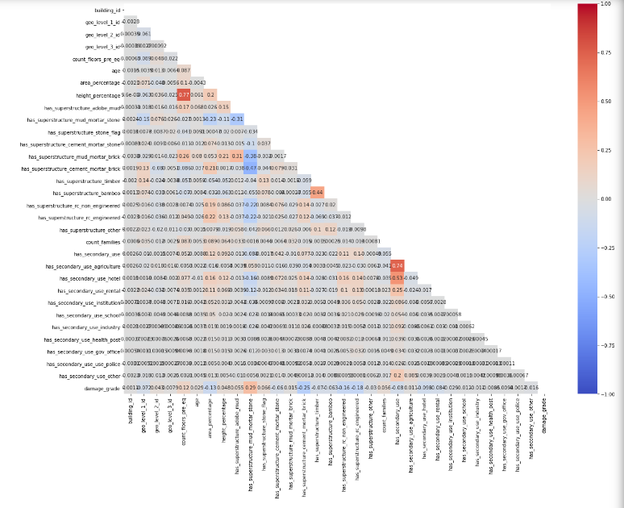
Feature Engineering & Correlation Matrix
Converted some numerical features into categorical features
Target encoding on categorical variables.
2 high correlations in the feature height and secondary use agriculture
2 pairs of variables had more than 70% correlation

Slide 6
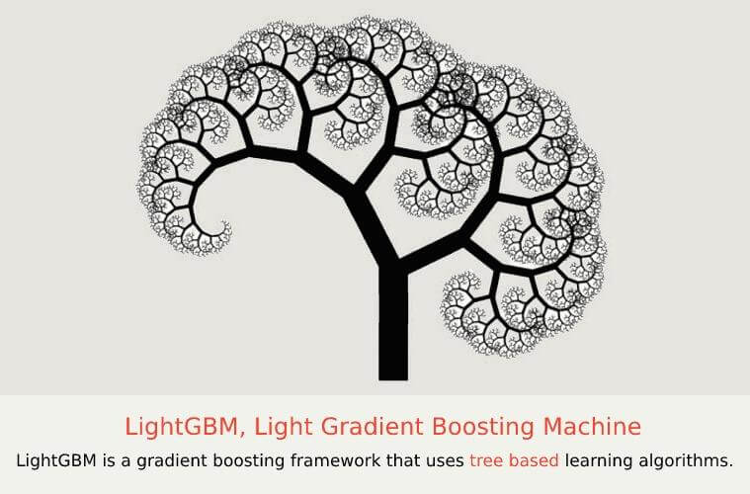

Cross Validation
XGB Classifier – 0.7472
Catboost classifier - 0.7520
RadomForest - 0.7444
LightGBM – 0.7538
DecisionTree – 0.6679
Logistic regression – 0.7209

Slide 7

Hyperparameter Tuning
TPE search is available in the Optuna package
Chooses new hyperparameters to test based on previous trials

Slide 8
Hyperparameter Tuning
Set intervals for search
Specify a range of possible values of parameters for tuning
Set number of trials
Specify the number of iterations for the search
Set Early Stopping Rounds
Compare the F1 macro scores to choose the best parameters
5-fold Cross-Validation
Pruning
Specify criteria to stop current trial if the score is not improving
Remove insignificant links from the decision trees

Slide 9

What Else We Tried
Scaling
Category Encoding
Feature Selection
Feature Engineering

Slide 10
Final Model - LightGBM
Parameter | Value
Objective | Softmax
Num_class | 3
Is_unbalance | True
N_estimators | 188
Learning_rate | 9.7%
Num_leaves | 1320
Min_data_in_leaf | 120
Max_depth | 120
Lambda_l1 | 30
Min_gain_to_split | 34.6%
Bagging_fraction | 90%
Feature_fraction | 60%

Slide 11
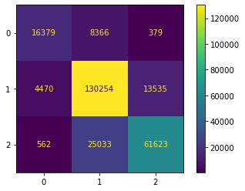
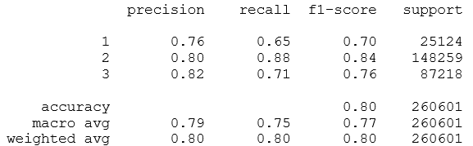
Model Performance
The overall F1-micro score is 0.7991373785979332

Slide 12
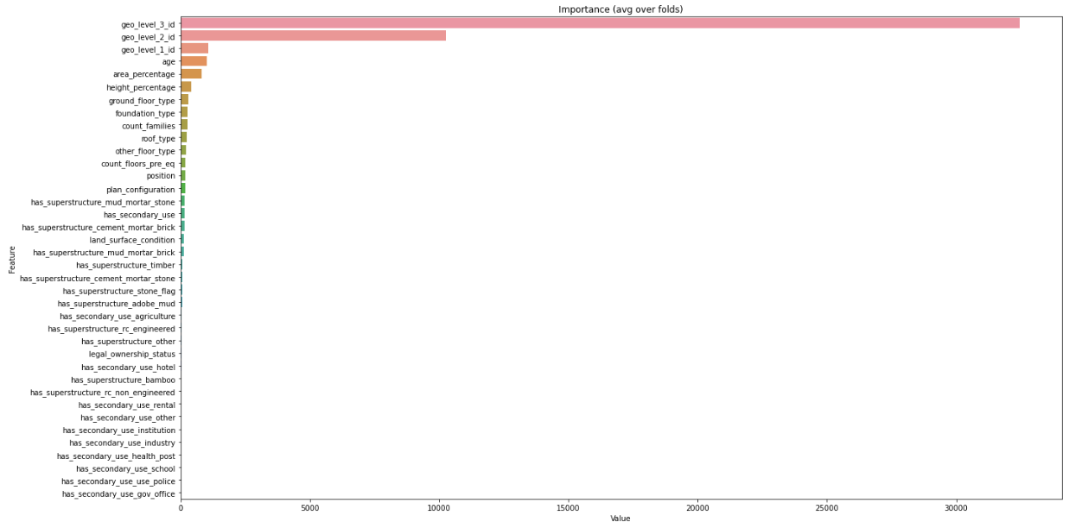
What the Model Learned
Most Important Features:
Location
Age
Area
Height
Ground Floor Type

Slide 13
Next Steps
Combining Models
Use models that learn differently, ex. K-nearest neighbors, SVM
Feature Engineering
Non-Linear transformations
Build a model using Neural Networks/ Deep Learning
Combine using Voting/Stacking
Creating new features from existing
Create features using Clustering

Slide 14

Lessons Learned
Trees based algorithms are the best
LightGBM gives speed and accuracy
Tuning significantly improves performance
Target Encoding is a safe bet

Slide 15
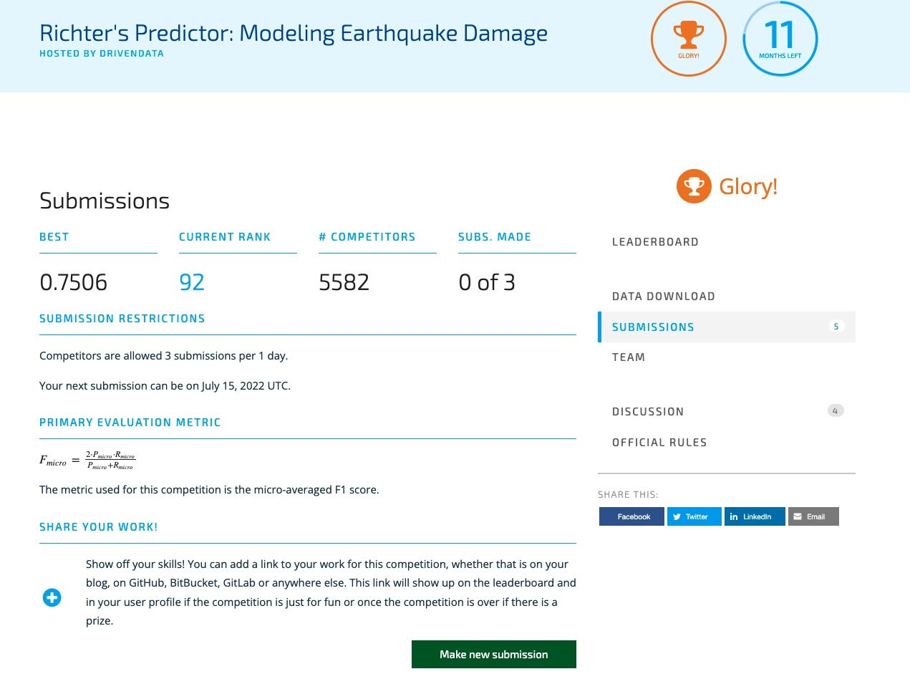
Submission
Notes:
Top 1.6%

Slide 16
Thank You

Slide 17
Q&A

Slide 18
Appendix

Slide 19
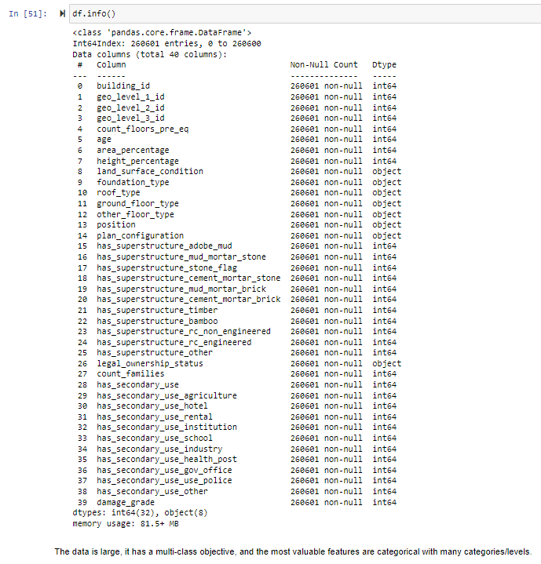
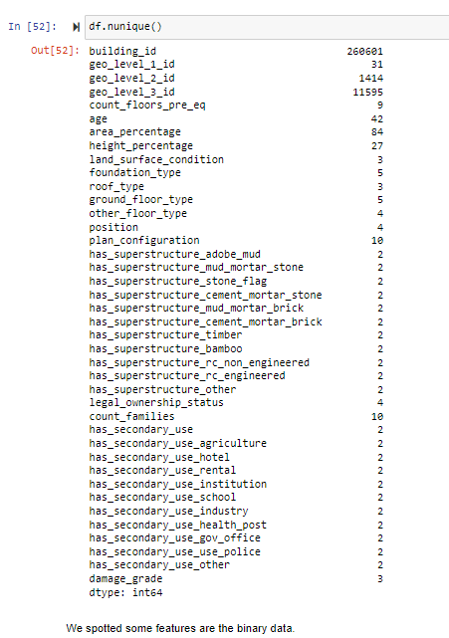
Data Overview

Slide 20
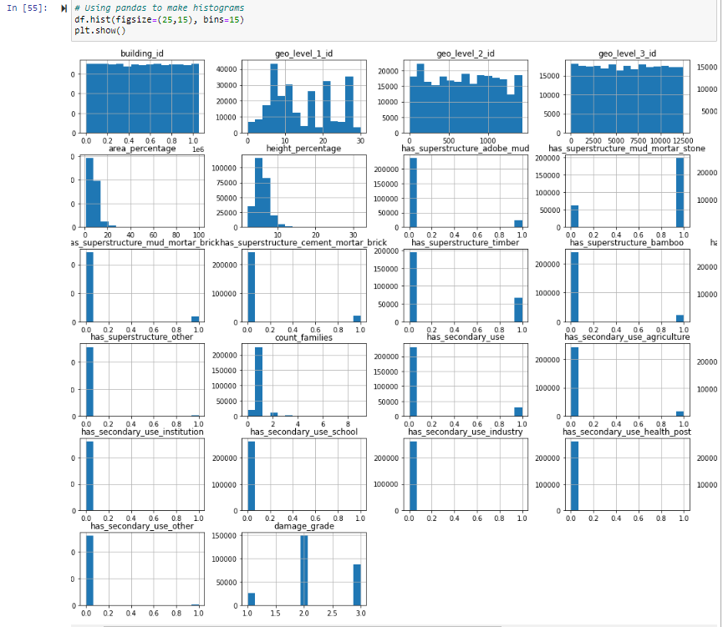
Histogram

Slide 21
Heatmap

Slide 22
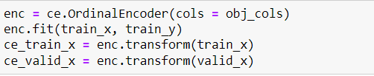
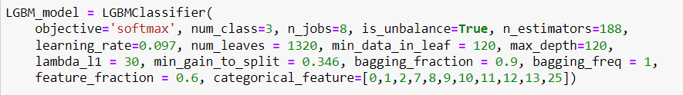
Target Encoding

Slide 23
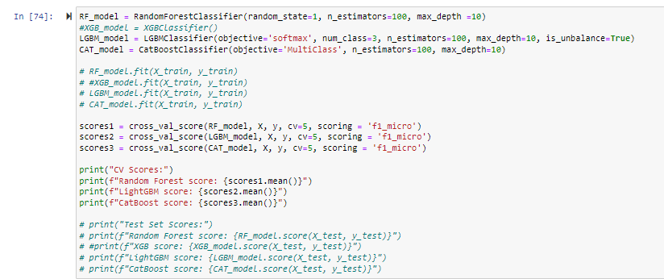
Cross Validation

Slide 24
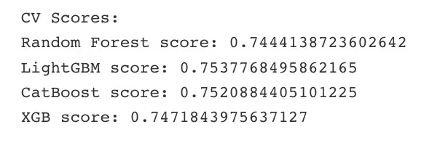
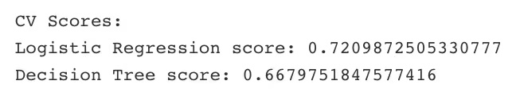
CV Scores

Slide 25
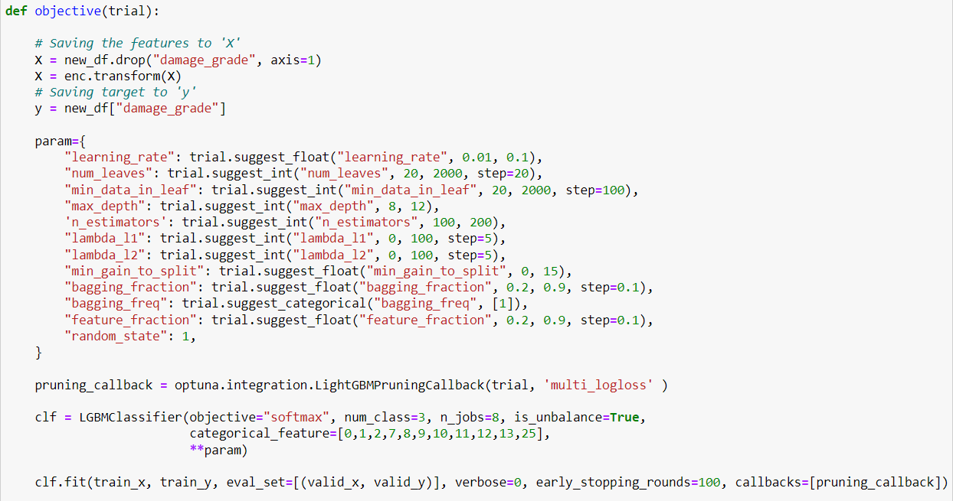
Hyperparameter Tuning

Slide 26
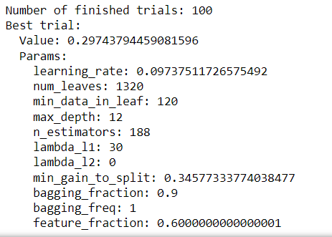
Best Trail

Slide 27
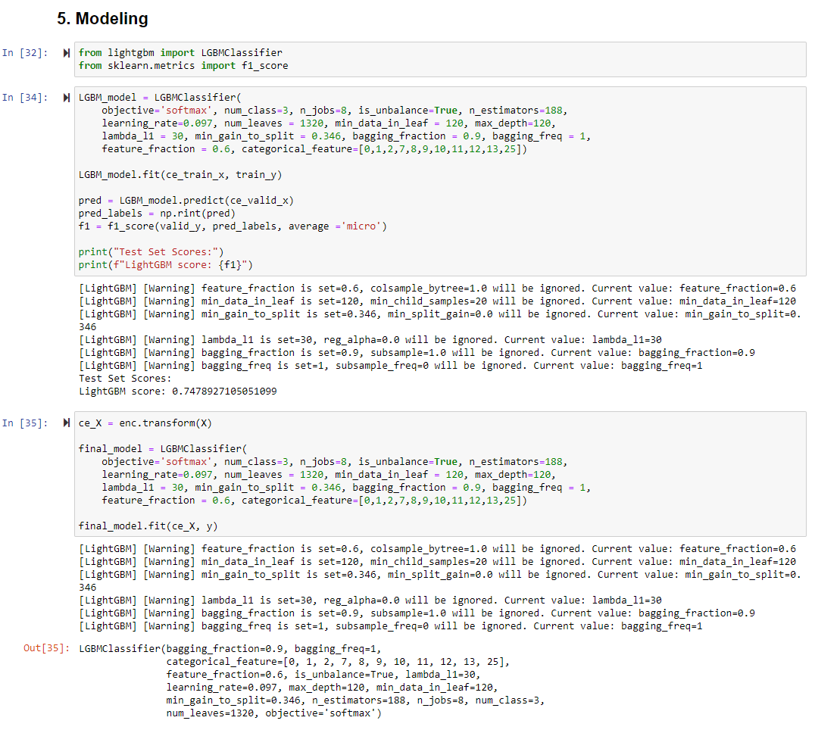
Final Model

Slide 28
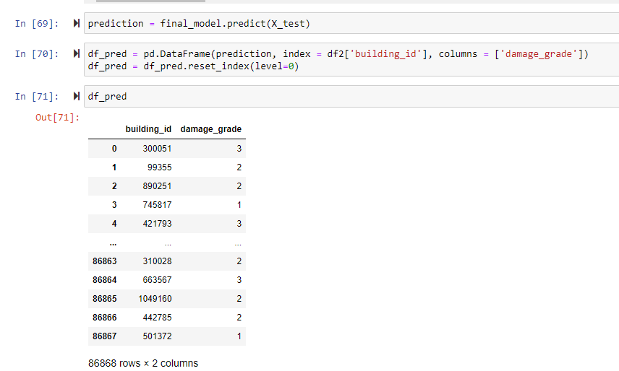
Prediction

